Slide 1
Domain Modeling
Tim Teaching ADBO
Semester Genap 2023/2024
Prodi D4 Teknik Informatika
Jurusan Teknologi Informasi

Slide 2
Learning Outcomes
After studying this material, students are expected to:
Refresh understanding of flow concepts and software development methodologies
Refresh understanding of the object-oriented software development paradigm
Understand the basic concepts of domain modeling
Understand the stages of the domain modeling process

Slide 3
Software Development Life Cycle

Slide 4
Software development life cycle
Flow, Role, and Deliverable (Tilley, 2012) (Dennis, 2016) (Valacich, 2017)
User/Product Owner brings requests for software requirements (changes) (System Request) to the System Analyst
System Analyst makes a feasibility analysis of the System Request.
The System Analyst carries out analysis and design, and the result is a System Specification
Business Analyst helps System Analyst understand the business processes of the software to be built.
System Specification diserahkan oleh System Anayst ke Programmer untuk dilakukan Konstruksi (Coding)
Hasil Konstruksi berupa Kode Program diserahkan ke Software Tester untuk dilakukan Pengujian (Unit, Integration, System, User Acceptance Testing)
Instalasi (delivery) software dan manajemen perubahan
Software = Kode Program + Dokumentasi (Pengembangan dan Penggunaan)
Siklus kembali ke 1 apabila ada permintaan perubahan (Permintaan Perubahan Software)
Planning (System Proposal)
Analysis and Design (System Specification)
Implementation (Software)
Maintenance (Updated Software)
4

Slide 5
Software development life cycle
Planning: Why should Software be developed?
System request
Feasibility Analysis (project size estimation)
Analysis: Who are the Software Users and Workflows?
Requirement gathering
Business process modeling
Design: What is the composition of software?
Program design
User interface design
Data design
Implementation: Construction and Software Delivery
System construction
Testing
Documentation
Installation
Planning (System Proposal)
Implementation (System)
Analysis (System Specification)
Design (System Specification)
(Tilley, 2012) (Dennis, 2016) (Valacich, 2017)

Slide 6
Software Development Methodology
A formalized approach to implementing the Software Development Life Cycle (Dennis, 2012)
A simplified representation of a software process (Sommerville, 2015)
A distinct set of activities, actions, tasks, milestones, and work products required to engineer high quality software (Pressman, 2015)

Slide 7
Software Development Methodology
More Prescriptive/ Documentation
Structured Design (Prescriptive) (1967- )
Waterfall method
Parallel development
Rapid Application Development (Iterative) (1985-)
Phased Development
Prototyping
Agile Development (Adaptive) (1995-)
Extreme Programming (XP)
Scrum
More Adaptive/ Communication
Compiled from (Dennis, Wixom and Tegarden, 2016)
7

Slide 8
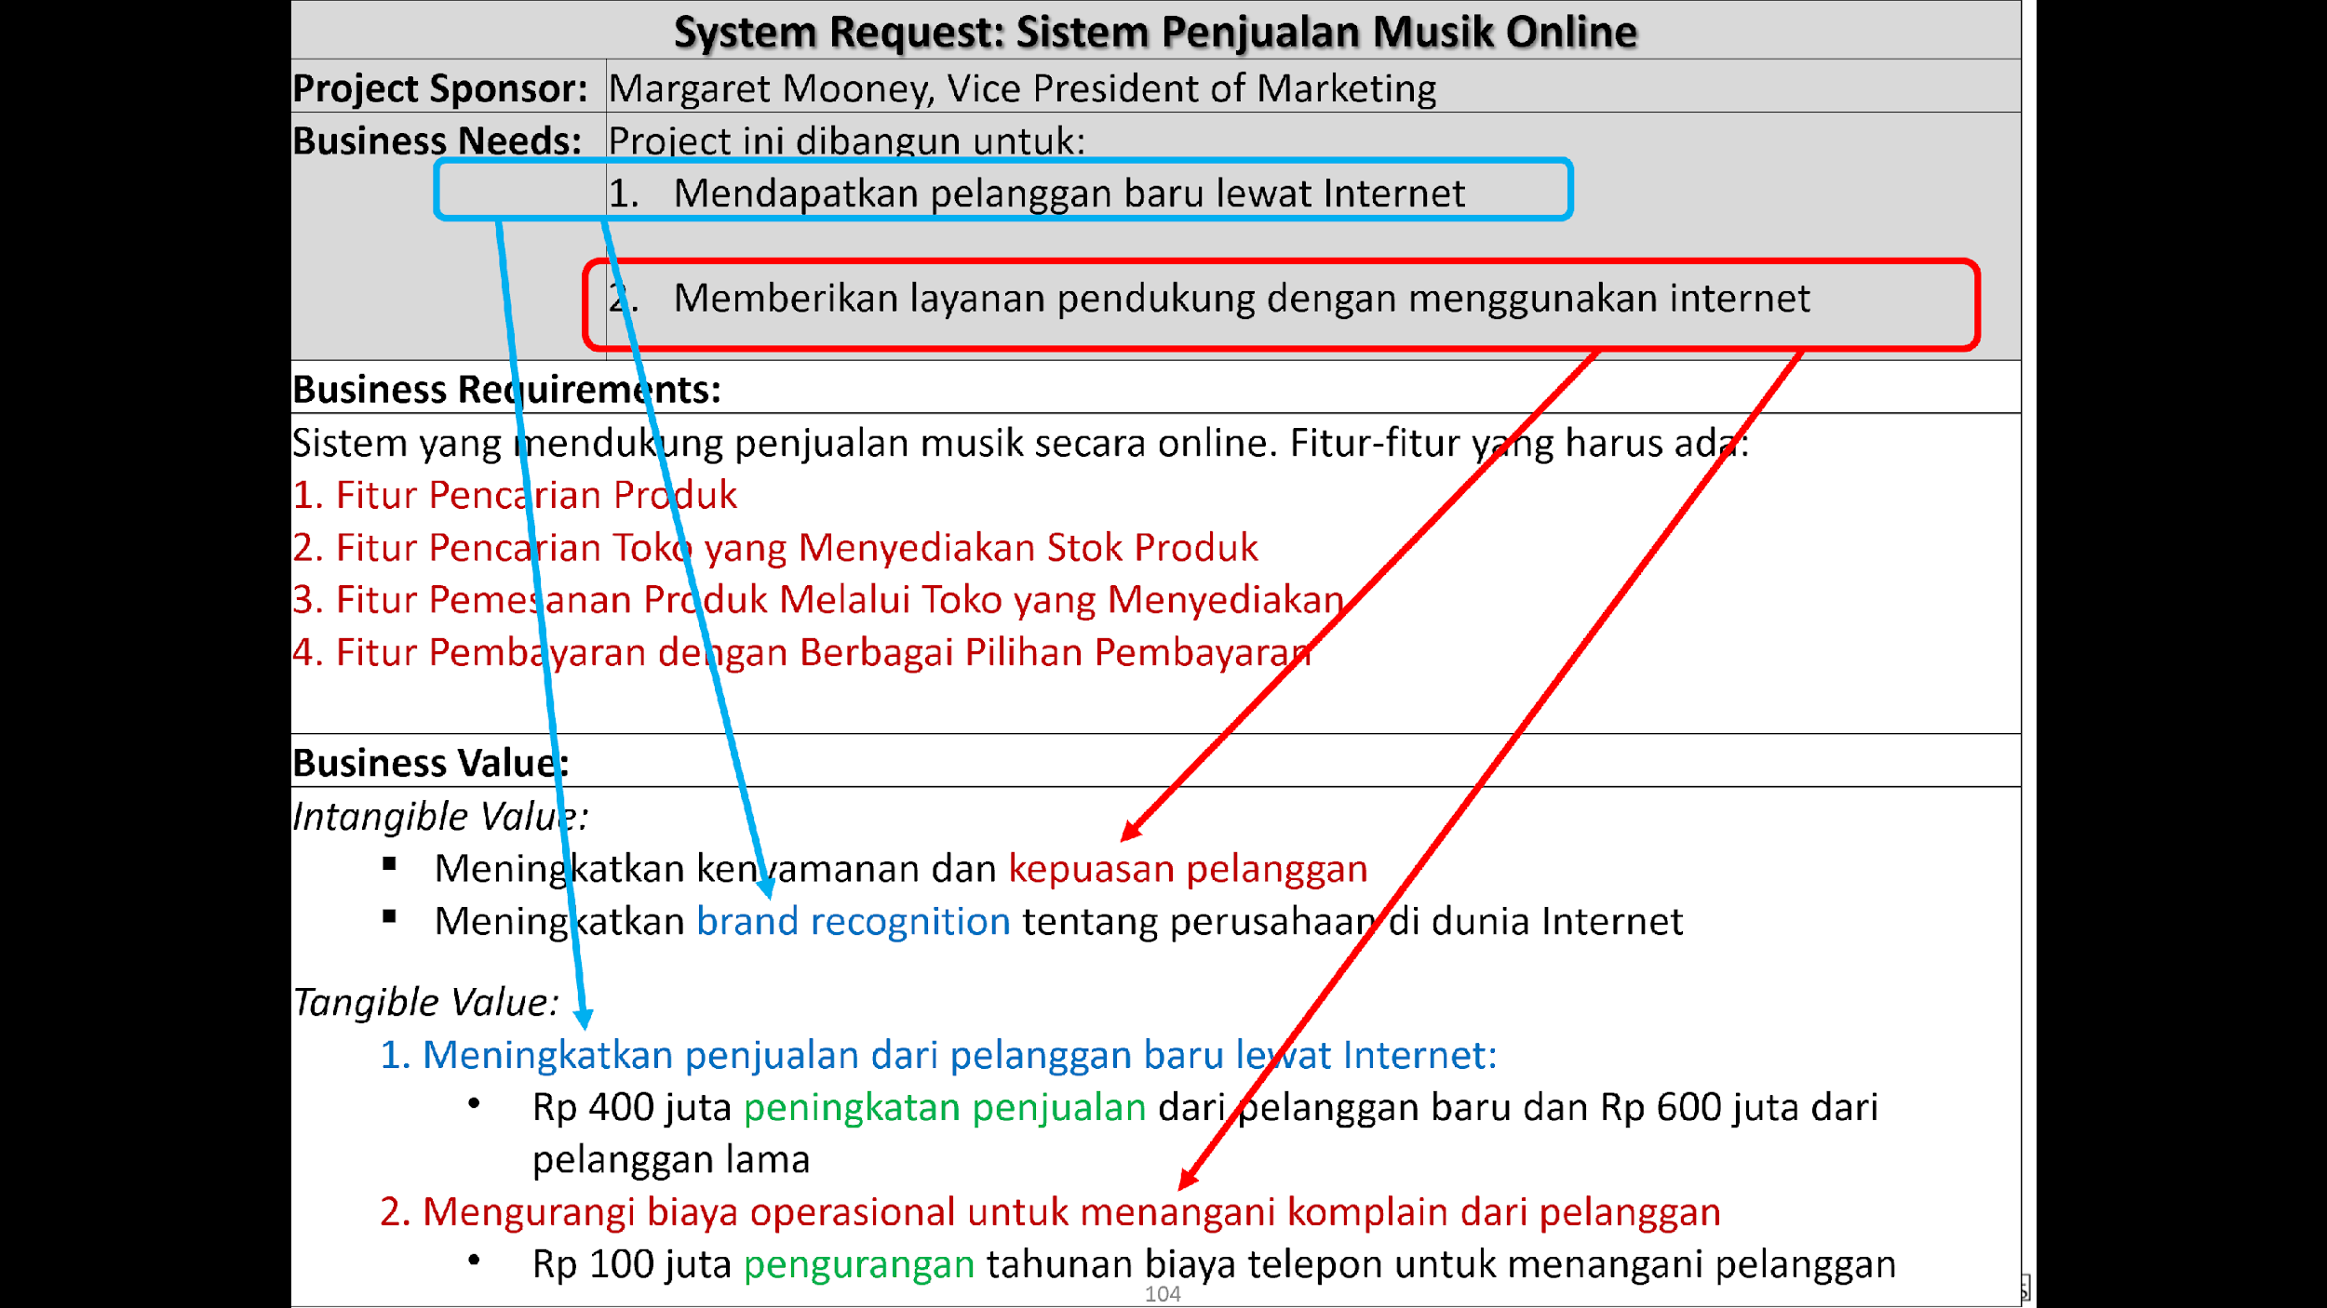
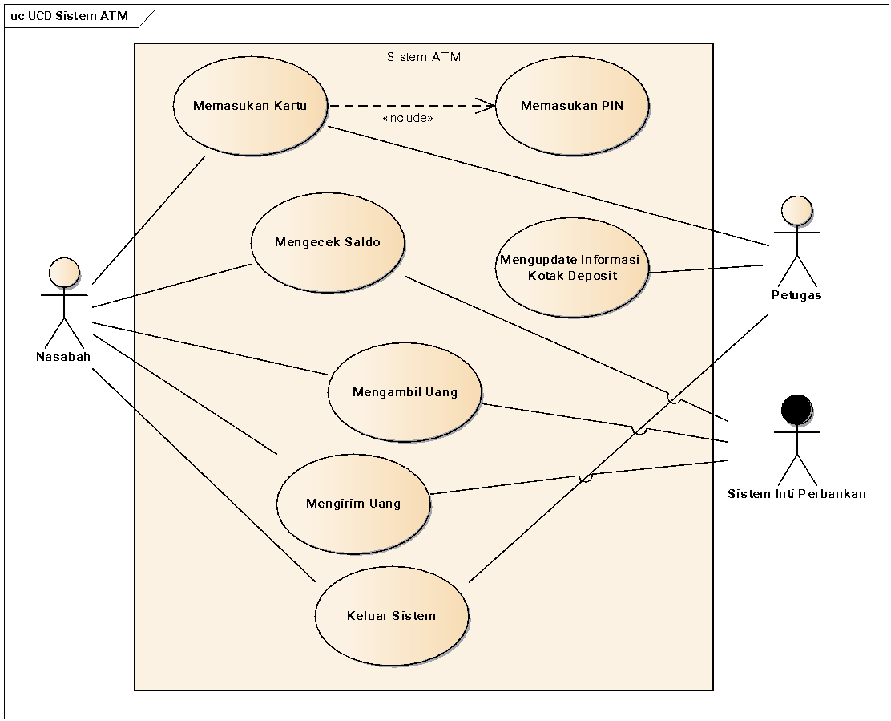
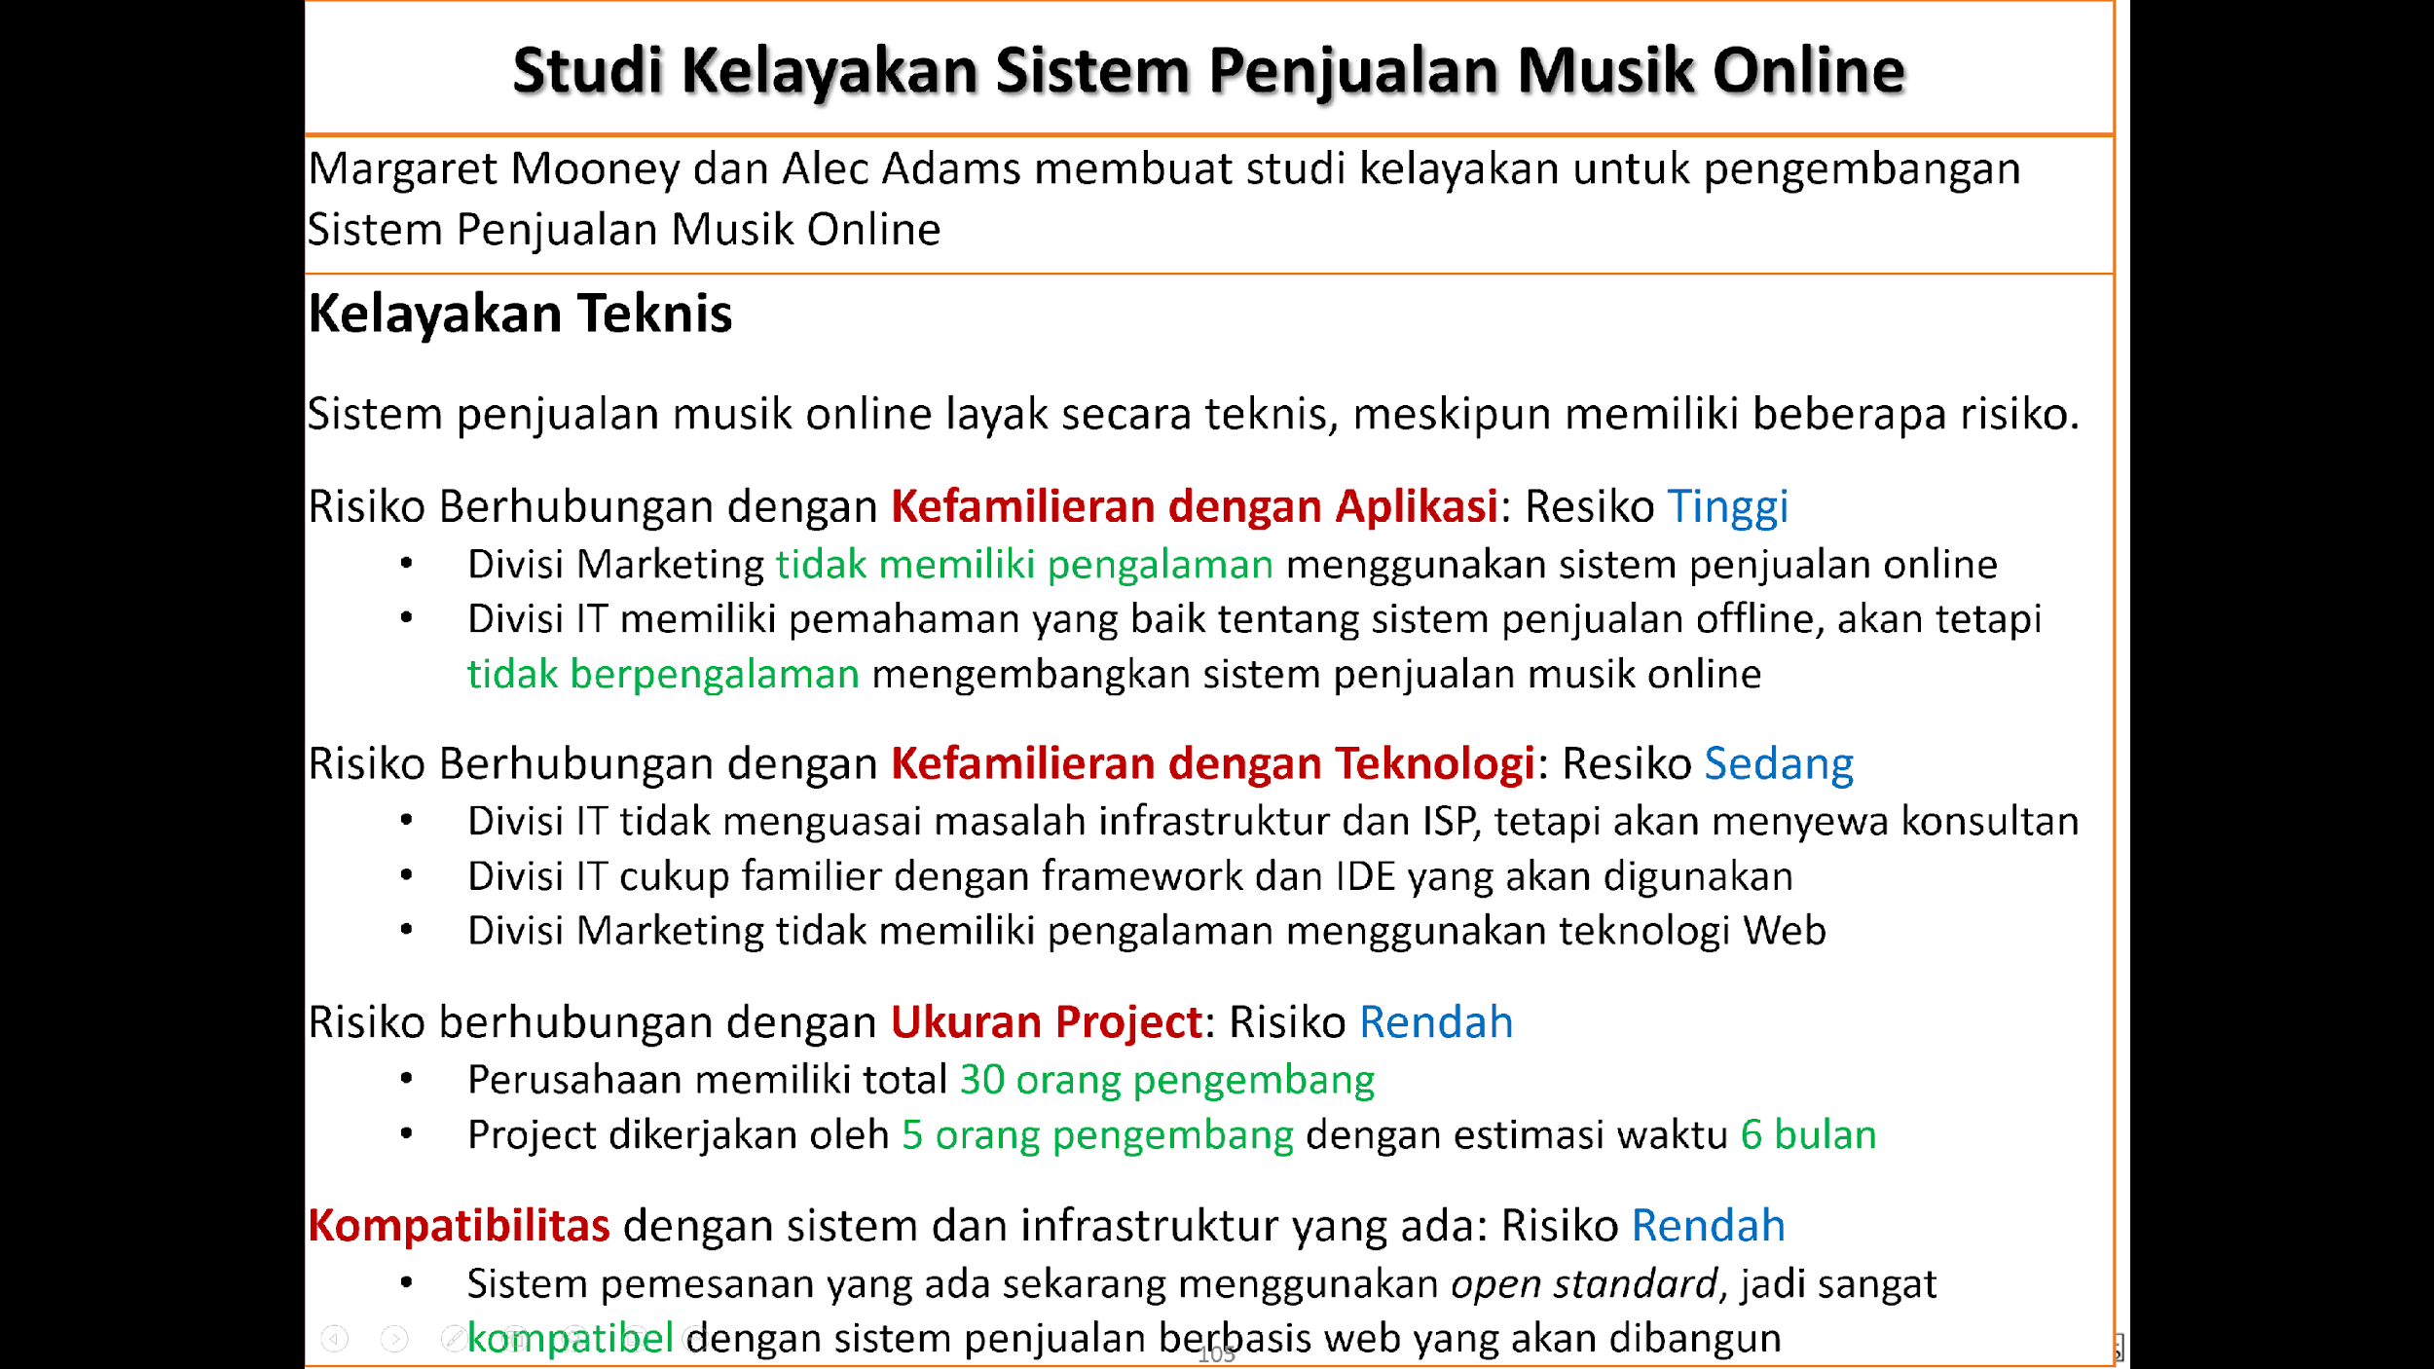
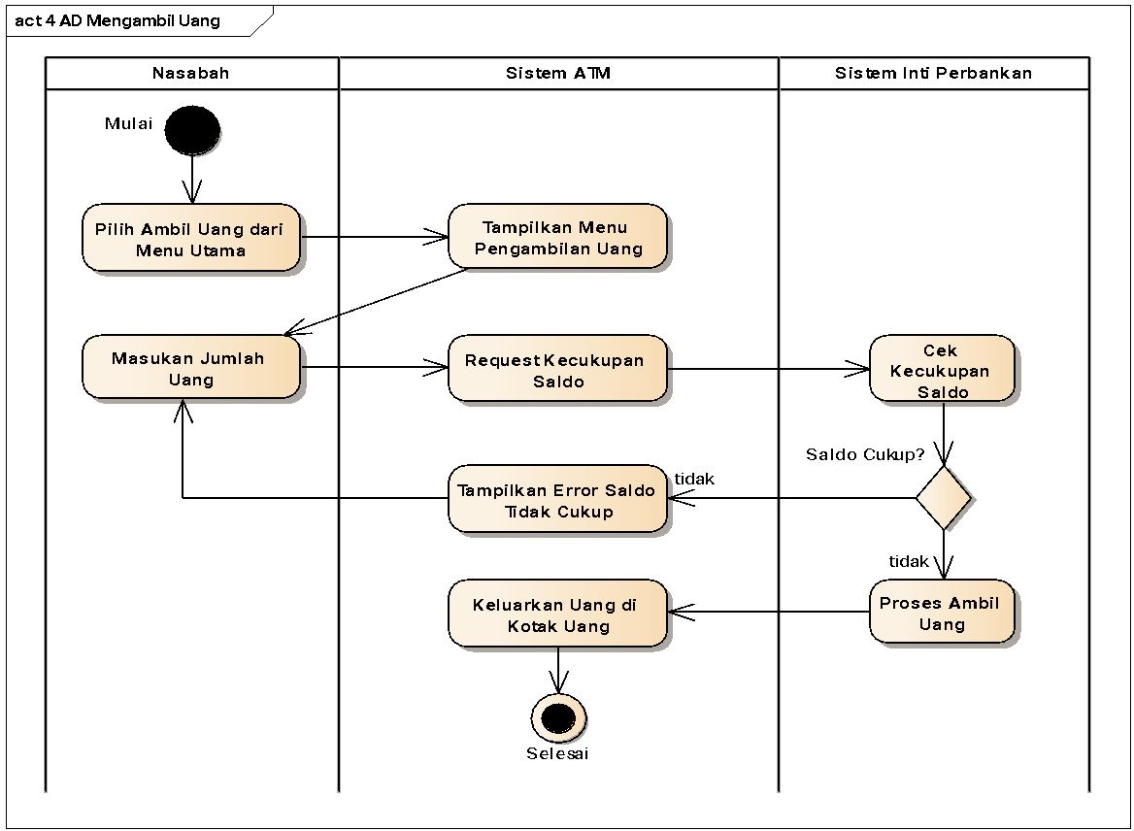
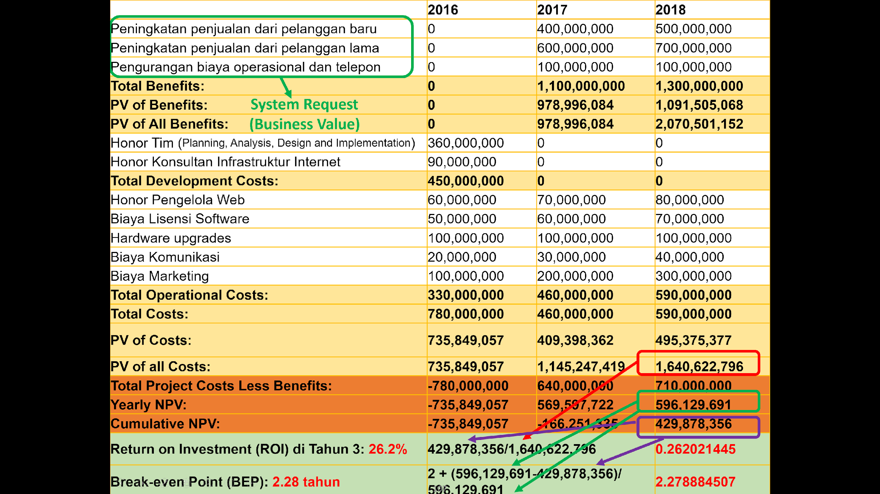
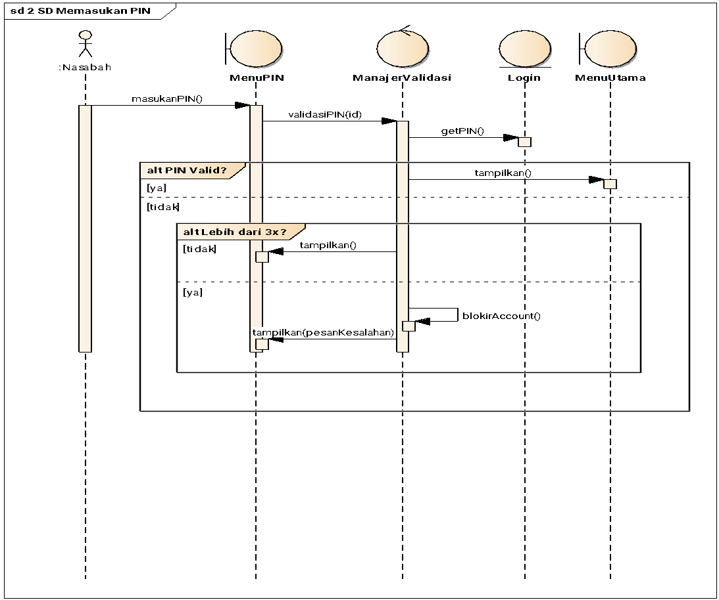
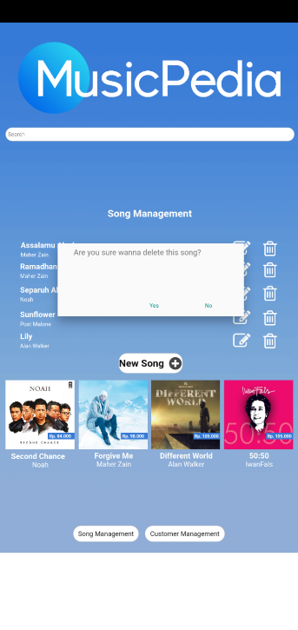
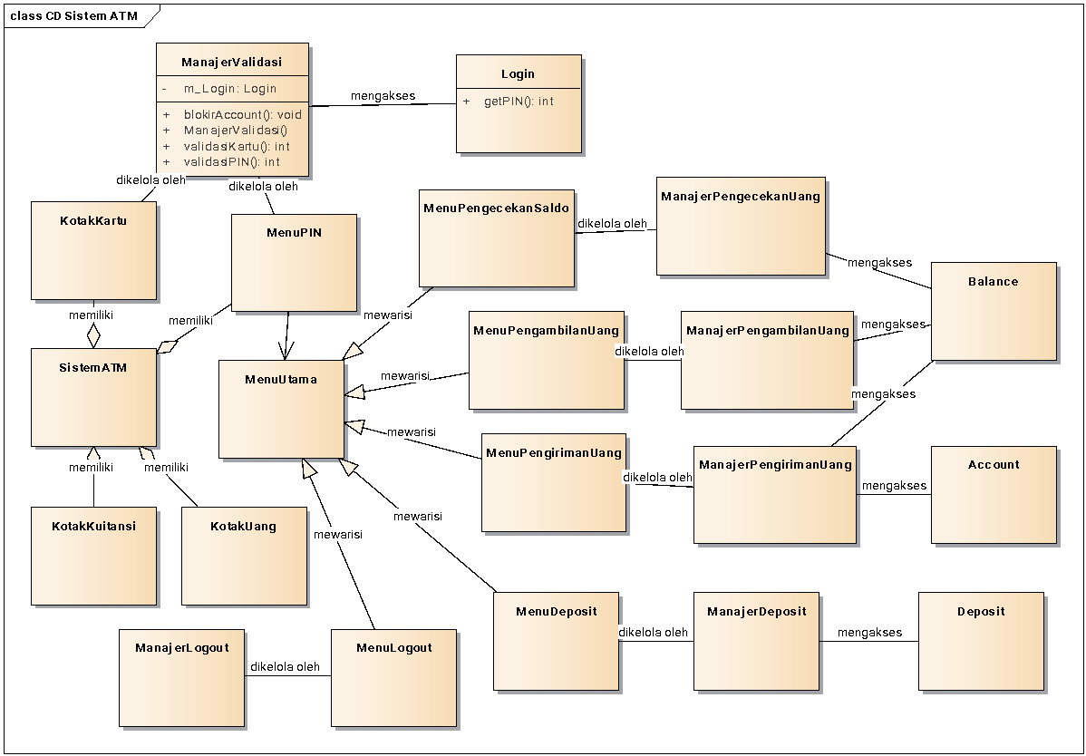
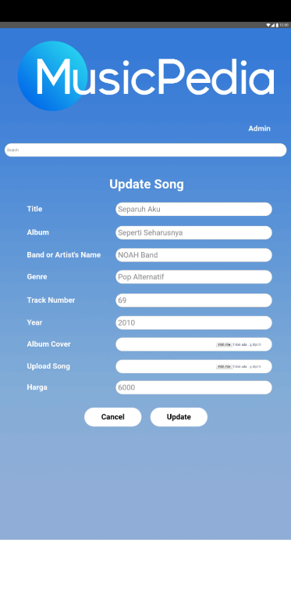
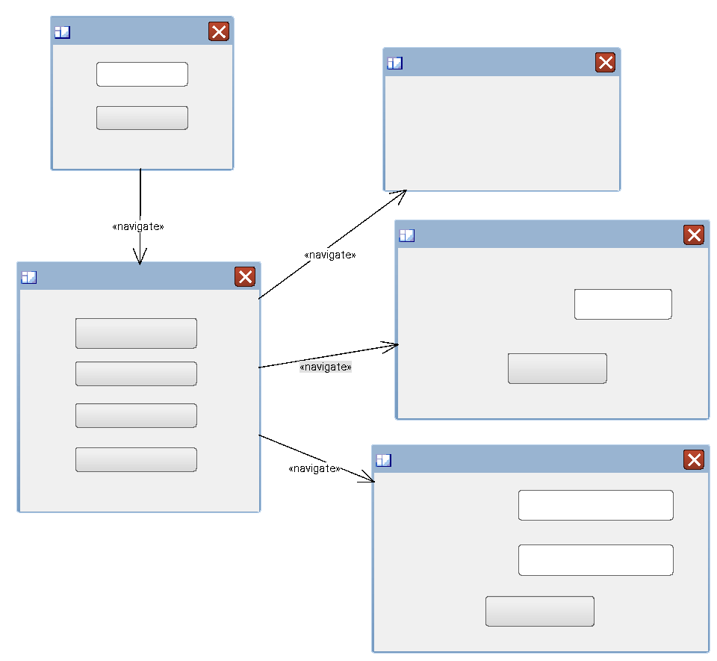
Planning
Analysis
Implementation
Design
Sumber: Unified Modelling Language, Romi Satrio Wahono http://romisatriawahono.net

Slide 9
Planning
Analysis
Versi 1
Versi 2
Implementation
Design
Sumber: Unified Modelling Language, Romi Satrio Wahono http://romisatriawahono.net

Slide 10
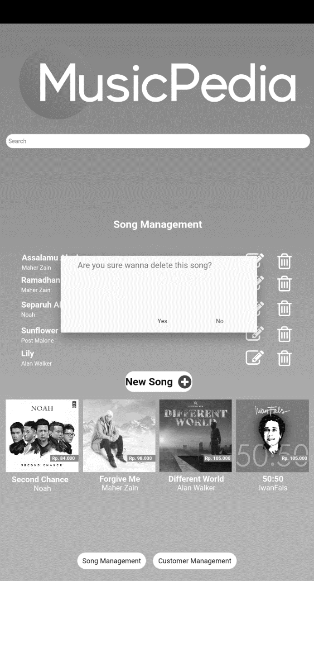
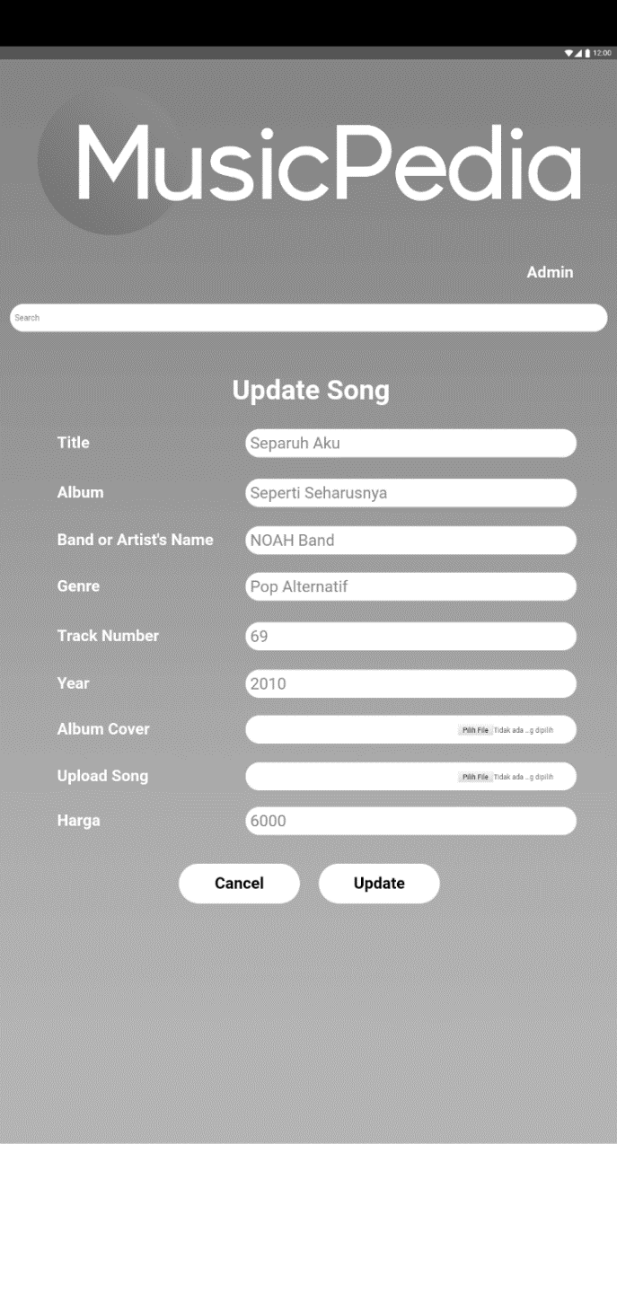
Prototype
Planning
Analysis
Implementation
Design
Sumber: Unified Modelling Language, Romi Satrio Wahono http://romisatriawahono.net

Slide 11
Planning
Analysis
Sprint 1
Sprint 2
Hasil Sprint 1
Hasil Sprint 2
Implementation
Design
Sumber: Unified Modelling Language, Romi Satrio Wahono http://romisatriawahono.net

Slide 12
Object-Oriented Software Development Paradigm

Slide 13
Paradigms in Software Development
Conventional Paradigm
Focus on Process (Input-Process-Output);
Data is separate from Procedure;
Functional Decomposition.
Object-Oriented Paradigm
Focus on Domain Object, not procedures;
Data and Procedures stored in Object;
Data/Object Decomposition

Slide 14
Conventional Paradigm
The conventional paradigm refers to a functional (algorithm) based decomposition strategy or event/process/sub-process partitioning.
This paradigm covers the entire system development process in full which includes:
Analisis terstruktur (structured analysis, DeMacro, 1978).
Perancangan terstruktur (structured design, Yourdon & Constantine, 1979).
SA/SD (structured Analysis and Strucured Design, Yourdon 1989).
Functional Decomposition = Functions + SubFunctions + Function Interfaces.
Function decomposition requires the intelligence of the system analyst to map the problem domain into functions and sub-functions. The problem is that functions are very volatile.

Slide 15
Paradigma Berorientasi Objek
Paradigma berorientasi objek adalah cara pandang yang bukan sekedar algoritma yang berbasis kepada objek dimana segala sesuatu dipandang sebagai objek.
Paradigma ini meliputi seluruh siklus hidup dalam pengembangan sistem.
Object Oriented Design (Booch 1991).
Object Oriented Analysis and Design (Coad & Yourdon 1989).
Object Modelling Technique (OMT) (Rumbaugh 1991).
Object-oriented System Analysis (Shlaer & Mellor 1988)
Object-oriented System Development (henderson-Sellers 1992).
Definisi Coad-Yourdon:
Berorientasi objek = objek + klasifikasi + pewarisan + komunikasi
Definisi Booch:
Berorientasi objek = abstraksi (objek) + pengkapsulan + modularitas + hirarki + [typing+konkurensi+persistensi].

Slide 16
Paradigma Berorientasi Objek
Metoda Berorientasi-Objek memberikan sekumpulan teknik untuk menganalisis, mendekomposisi dan memodularisasi arsitektur sistem perangkat lunak.
Metoda Berorientasi-Objek dikarakterisasikan dengan menstrukturkan arsitektur sistem berbasis objek-objek dan kelas-kelas.
Kepentingan penggunaannya:
Umumnya sistem berkembang dan fungsi-fungsinya berubah, tetapi objek-objek dan kelas-kelas tetap stabil setiap waktu.
Digunakan untuk sistem-sistem berukuran besar.
Digunakan untuk sistem-sistem yang sering berubah.

Slide 17

Object Oriented vs Conventional Paradigms
1. Paradigma Konvensional
Tingkat - Kebutuhan
Tingkat - kode
Sistem
1:1
Fungsi A
1:1
1:1
Fungsi B
2. Paradigma Berorientasi Obyek
Statechart
Diagram
Statechart
Diagram
Class A
Class B
Operation
Schemata
Class Diagram
Operation
Schemata
n:1
n:m

Slide 18
Object Oriented vs Conventional Paradigms
The conventional paradigm focuses on:
Decomposition of the system into a number of functions in a hierarchical structure (modules).
Processes and Procedures for each module.
The object-oriented paradigm focuses on:
Objects in the real world that work together (not hierarchical).
Models of objects in the real world (scenarios).
The role of these objects in describing software systems (methods).

Slide 19

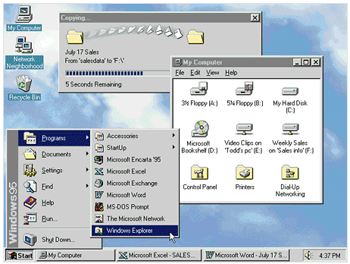

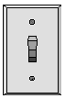


Object
Usually in the form of an object or an event
Real object : plane, lamp, book, …
Concept : Shopping cart, lecture, …
Abstract : company, business, school, …
🖰

Slide 20

Attributes of Object
ATTRIBUTES:
Is an internal value or data related to an object that shows:
Characteristics or properties of object
Description of the state of the object
Warna
Nama objek: Mobil
Atribut:
Merek : Toyota
Silinder : 2000 cc
Warna : Merah
Status : Baru/Jalan
Tahun : 2004
Tipe mesin
Panjang

Slide 21


Object Method/Behaviour/Function
Behavior defines how an object acts and reacts, and relates to the function applied to an attribute.
The object's behavior is called a service method or operation.
Swim
Diver
Fish
Mobil bisa bergerak, meyalakan lampu, membunyikan klakson

Slide 22
Object
Object
Object
Attributes
messages
Methods
Object is a collection of attributes (data) together with a combination of methods (functions) used to operate on these attributes.
Object = Attributes + Methods
The outside world communicates to objects by sending messages.

Slide 23
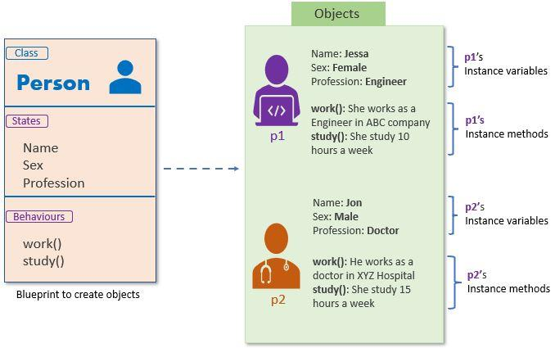
Class vs Objek
A class is a design for an object, and an object is the result of an instantiation of a class.

Slide 24
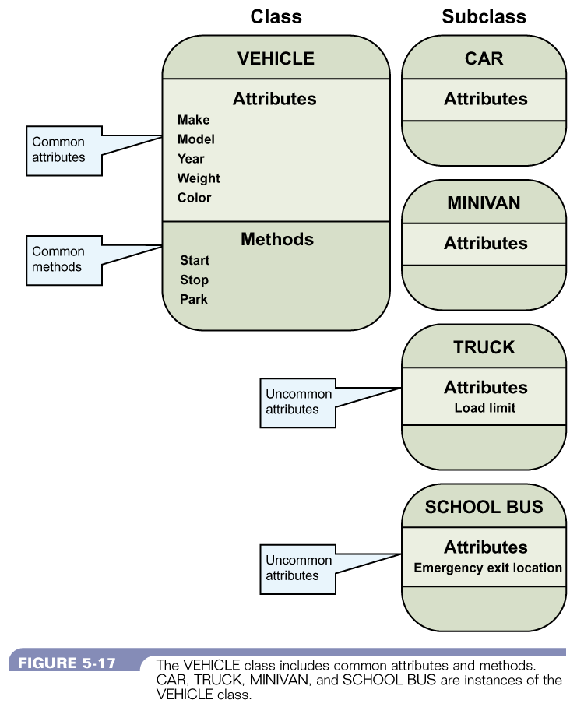
Inheritance
Inheritance, a more general class to a more specific class
Also called generalization or is-a relation.

Slide 25
Domain Modelling

Slide 26
Understanding Domain Modeling
In the previous semester, you created an application, which started from a class design
The class design is usually depicted in a class diagram (in this course, class diagrams will be discussed in more detail later)
Analysis of class diagram formation is a core activity that greatly influences subsequent program coding models
So, where do we start analyzing and identifying these classes?

Slide 27
Understanding Domain Modeling
Domain Modeling is a technique of identifying objects through nouns contained in a list of requirements that are classified in the same problem area (domain) to become candidate classes or candidate objects.
The model domain is the foundation of the static part of a system model
The starting point for starting domain modeling is the requirements or system needs of the user/client
Collecting a good list of requirements will produce a good domain model

Slide 28
Requirement Gathering
You can use a model diagram that can describe needs and relationships with other needs, for example a Mind Map diagram. Mind maps can help improve more detailed needs exploration
Focus on functional needs first. The use of dysfunctional requirements statements that do not describe the function of a system can be limited first
Avoid using technical language such as returns, parameters, void, int etc. so that the requirements statement can be easily read
Test case scenarios for each requirement can be identified simultaneously, so that the resulting requirements can be tested
Classify needs into different types to form problem domains
Treat every need you get as very important
Try your best and focus on the needs exploration process. Especially if you meet clients who are not tech-savy. We need to try to lead and trigger so that client needs can be conveyed

Slide 29
Domain Modelling Rules
Domain model analysis must focus on real-world objects contained in a domain or problem area
In the early stages, the domain model results may not be final and will develop along with software engineering activities (domain model updates). So it doesn't take too long at this initial stage
For the initial model domain, ensure that the analysis carried out focuses on the problem domain (area). Don't mix it with classes related to the user interface
If it is necessary to describe relationships between objects, try to use class relationship patterns (inheritance, composition, aggregation, etc.)

Slide 30

Help!
I want to create an online bookstore, but I don't know what the online bookstore should do.
Can you help me to find out the abilities that an online bookstore should have?

Slide 31
High Level Requirements from Previous Meeting (1)
The bookstore must be a web-based application
The user must be able to create a customer account
The system shall maintain a list of accounts in database
When a user logging in, his/her username and password must always be matched against the password in the master account list
The bookstore must be able to sell books with order accepted over the internet
The user must be able to add books into an online shopping chart, prior to checkout (vise versa)
The books should be stored in master catalog in database system

Slide 32
High Level Requirements from Previous Meeting (2)
The user able to add books into a wish list
The user must be able to pay by credit card, digital wallet, or other payment channel (through convenience store)
The user must be able to search book by various search methods – by title, author, keyword, or category – and the view the book’s details
The user must be able to post a book’s reviews. It should be containing a customer rating (1-5)
Book reviews must be moderated by staff before published on the website
The customer may click to view full review on a separate page

Slide 33
Can you find the “objects”? (1)
The bookstore will be web based
The user must be able to create a customer account
The system shall maintain a list of accounts in database
When a users logs in, his/her username and password must always be matched against the password in the master account list
The bookstore must be able to sell books with orders accepted over the internet
The user must be able to add books into an online shopping chart, prior to checkout (vise versa)
The books should be stored in master catalog in database system

Slide 34
Can you find the “objects”? (2)
The user able to add books into a wish lists
The user must be able to pay by credit card, digital wallet, or other payment channel (through convenience store)
The user must be able to search book by various search methods – by title, author, keyword, or category – and the view the book’s details
The user must be able to post a book’s reviews. It should be containing a customer rating (1-5)
Book reviews must be moderated by staff before published on the website
The customer may click to view full review on a separate page

Slide 35
List the “objects” first
Books
Bookstore
Checkout
Customer Account
List of accounts
Master account list
Order
Password
Shopping chart
System
User
Username
Author
Book Detail
Book Review
Category
Credit card
Customer
Customer Rating
Digital wallet
Keyword
Other payment channel (convenience store)
Search method
Title
Wish list

Slide 36
Let's remove the “unnecessary object”
Book
Bookstore
Checkout
Customer Account
List of accounts
Master account list
Master catalog
Order
Password
Shopping chart
System
User
Username
Author
Book Detail
Book Review
Category
Credit card
Customer
Customer Rating
Digital wallet
Keyword
Other payment channel (convenience store)
Search method
Title
Wish list

Slide 37
Updated List of “Object”
Book
Checkout
Customer
Customer account
Master account list
Master catalog
Order
Shopping chart
Author
Book review
Category
Credit card
Customer rating
Digital wallet
Other payment channel
Search method
Wish list

Slide 38
So, what is the “object” then?
Why we get rid some of “objects” in our list?

Slide 39
The Objects: Psss! We make it simple for now (1)
Objects is “something” that interact to achieve software the system objective
The objects usually mimic the real-world object
The real-word objects may have physical present or just represent well-understood conceptual entity in the application. Examples:
Book (physical)
Book review (conceptual)

Slide 40
The Objects: Psss! We make it simple for now (2)
Objects are characterized by having both attribute (state) and behavior
The attribute is the information of the object. For example:
Title, ISBN, publisher, so on
The behavior is something that the object can do (action). For example:
Give an information about book title (get title)
Set the ISBN
etc
The object in an instance of the class (we will talk about class later)

Slide 41
Revisit
Book
Bookstore
Checkout
List of accounts
Master account list
Master catalog
Order
Password
Shopping chart
System
User
Username
Author
Book Detail
Book Review
Category
Credit card
Customer
Customer Rating
Digital wallet
Keyword
Other payment channel (convenience store)
Search method
Title
Wish list

Slide 42
Determine the relationships of the objects
Class Notation
This is the object
“Is-a” relationship
Generalization
“has-a” relationship
Aggregation

Slide 43
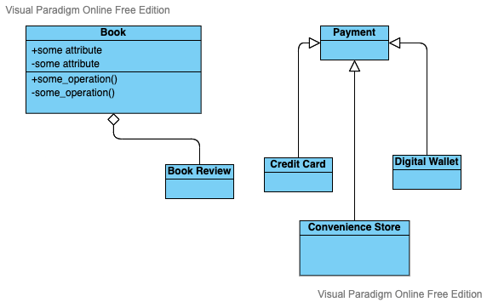
Example

Slide 44

Discussion Time!
According to your requirements, please define the objects and determine the relationship between them.
Duration : 30 minutes

Slide 45
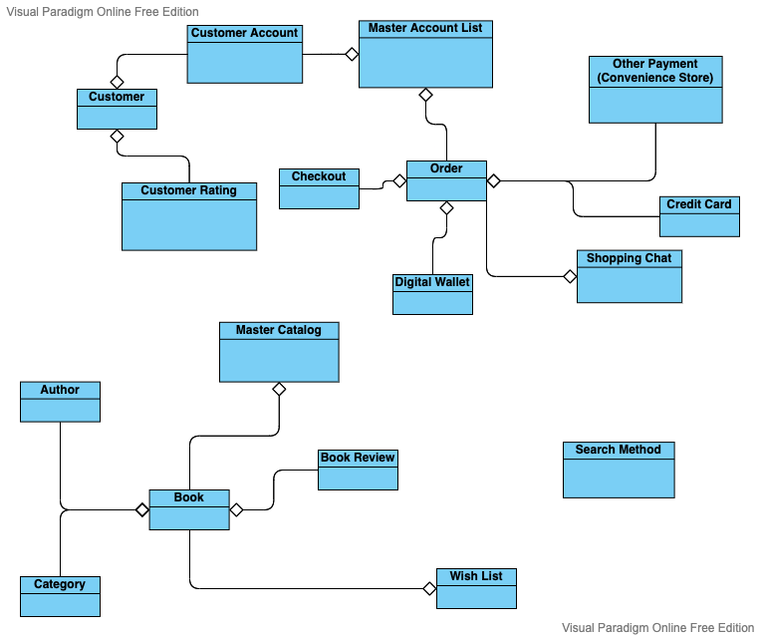
1st attempt domain model

Slide 46
Homework Task
Please refine your domain model in order to make your object identification clearer (at least for now ☺)
You can identify the new object(s)
You can refine the relationship

Slide 47
Next?
Use Case Diagram

Slide 48


